Slide 1
Candor
A Java Chat Server

Slide 2
The Team
Dylan LeMay - Backend Developer
William Smith - Frontend Developer
Sean Gately - Backend Developer
Andrew Lavender - Frontend Developer

Slide 3

Why a Chat Server?
Decided early on server project
General interest in server technology
Seemed like a reasonable level of challenge

Slide 4

Server and Client
Servers work through a server-client model
The ‘server’ provides service to clients
Function through a request-response model
Can communicate on the same hardware or through a network

Slide 5
The Server Side
Is an abstraction of computer resources
Capable of serving many clients at once
Waits to accept connections from connecting clients

Slide 6
The Client Side
Utilizes the services provided by a given server
Clients interact through a server through sockets

Slide 7
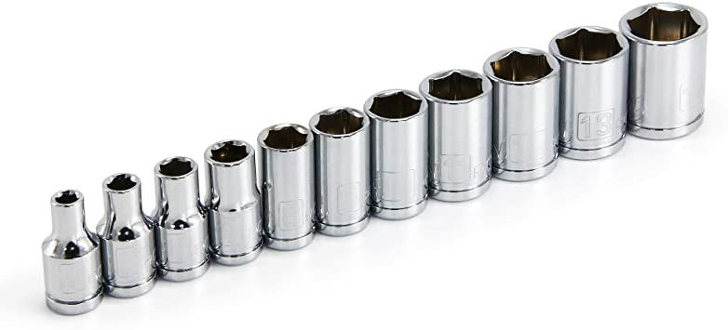
Socket Programming
Socket: an endpoint within a two-way communication between a server program and a client program
Enables communication between two processes
Processes can be on the same computer or one different ones
In java, this is achieved using a built in socket type(Located in java.net.*)
A socket object on the client side requires the IP address of the server.
The server program uses a special serversocket object, which waits for a client socket.

Slide 8
The GUI
A single GUI is used
The server side was kept text-based since it was already so simple
A GUI was implemented on the client side to be easier on the eyes
The implementation of the GUI lead to some major changes in the client package

Slide 9
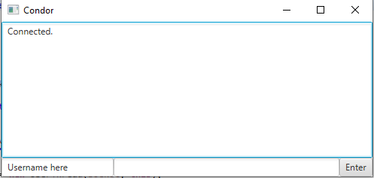
Components of Client GUI
TextArea for chat room
Textfield for username
Textfield for message
Button to send message

Slide 10
Demonstration

